Slide 1
Adobe PE SERVICE MANAGEMENT REVIEW Q1 2026

Slide 2
Agenda
Key Discussion Items
Challenges from Previous Quarter(Q4 2025)
PE team contributions in Q1
Current challenges & Q2 Focus areas
Feedback & Next steps

Slide 3
Challenges as of Previous quarter
Key Challenges
System capacity optimization
ACM high DB utilization(80), risk of storage constraints and performance impact
ACM – Absence of structured capacity analysis framework
Limited monitor coverage
ACM – RTIM batch rejects – lack of alerting
ACM – New market onboarding (TW,UAE) , monitoring coverage gaps
ACM – Bounce rate and delivery metrics
Manual Work
ACM - (Prospect)Active Profile Volume
ACM - HK SMS auto reply Keywords update
CDP - License usage metrics (under review)
CDP – Health check
WorkFront – Health Check(under review)

Slide 4
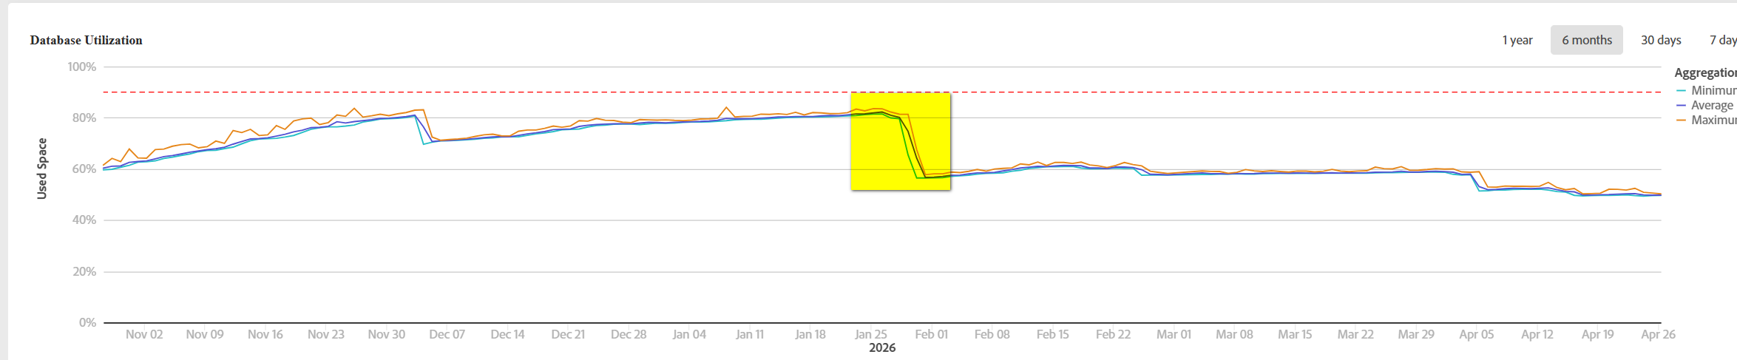
System capacity optimization-DB Shrink
Database shrink by moving archive data from Postgres to snowflake
Eliminate monthly DB vacuum activity

Slide 5
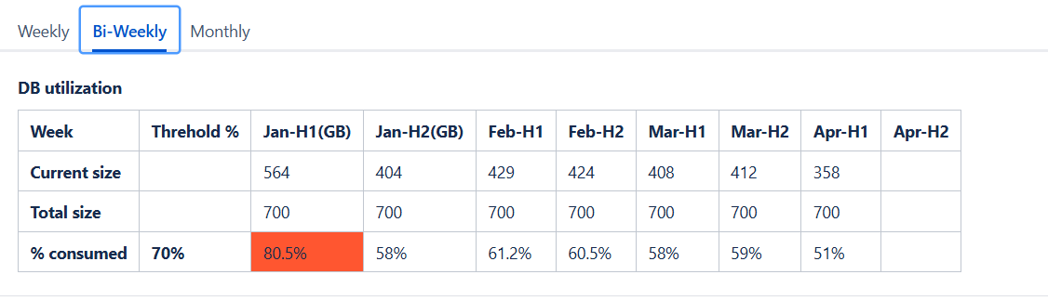
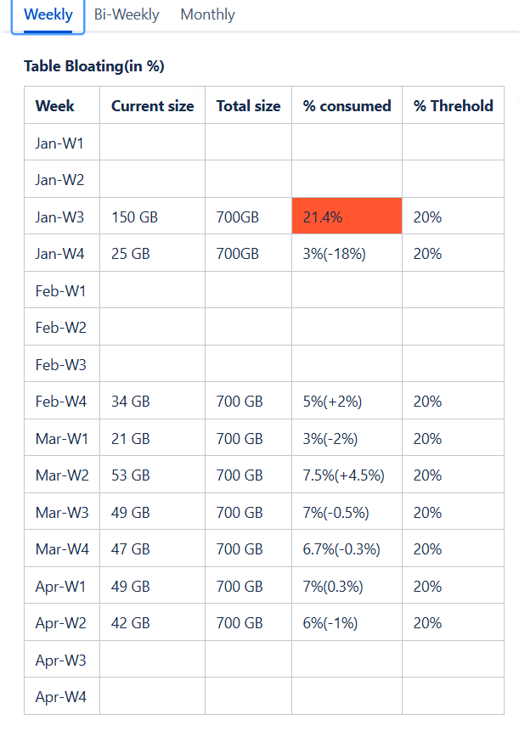
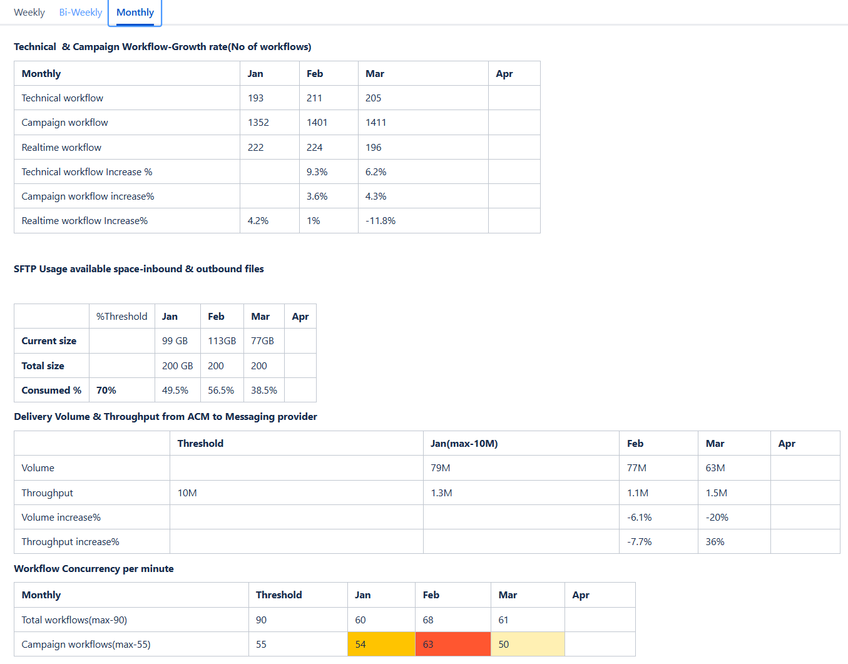
System capacity optimization-Capacity Review
Introduced structured capacity review covering DB size, table bloat, SFTP usage , workflow concurrency, delivery volume etc

Slide 6
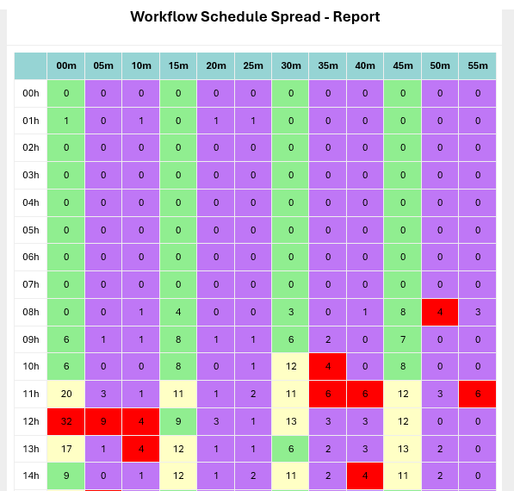
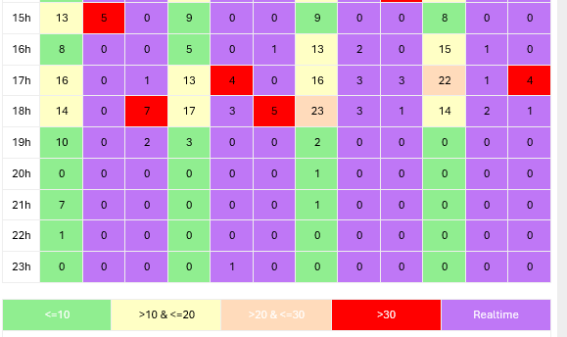
System Stability - Batch Scheduler Heatmap extension
Extended scheduler visibility to 24 hours from 12 hours
Direct insight of workload distribution across the day

Slide 7
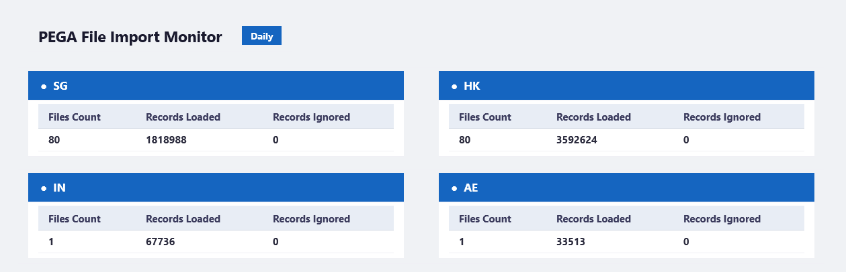
Monitoring - PEGA File data loading reject alert
PEGA file import failures and rejected records Monitor
Reduce risk of missed campaign executions due to data load failures

Slide 8
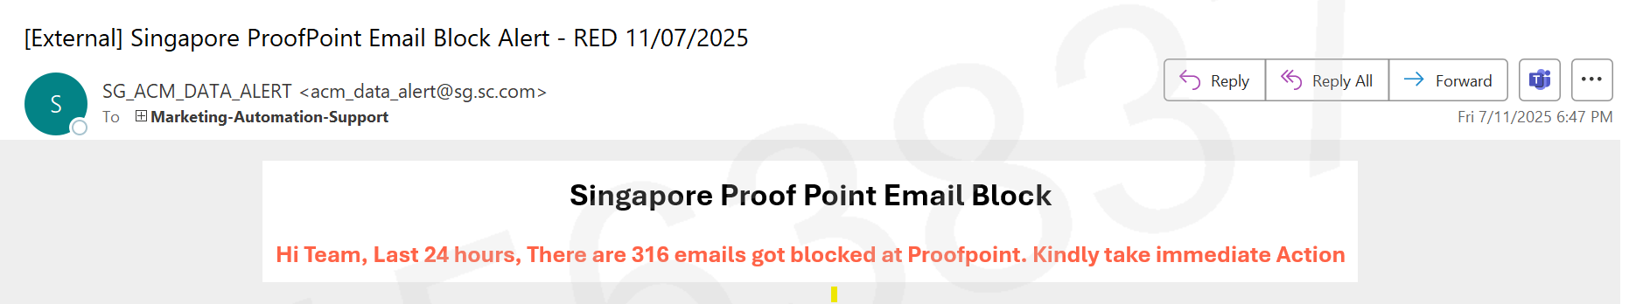
Monitoring - Proofpoint Block (TW, UAE) alert
Email blocking events monitor
Enables immediate action and helps maintain delivery performance

Slide 9
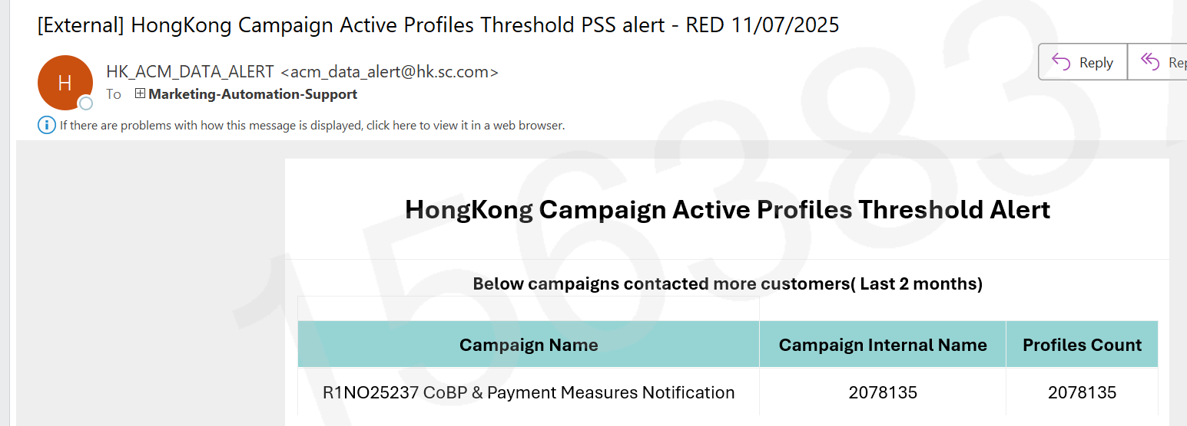
Monitoring - Active Profile Threshold Alerts(TW, UAE)
Configured automated alerts for monitoring profile targeting thresholds
License monitoring – Incase any campaign targeting more than threshold customers count

Slide 10
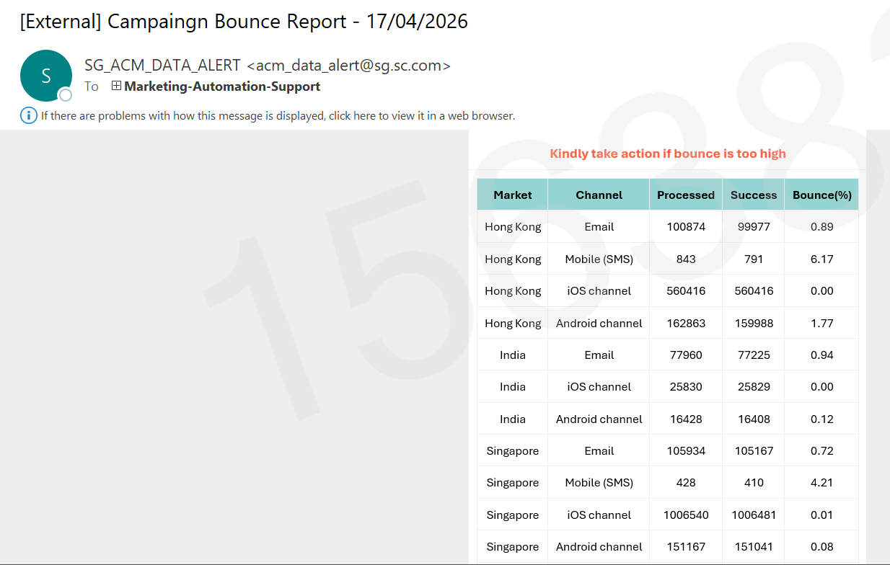
Monitor – Channel-wise bounce Report
Daily automated bounce tracking across markets
Enables proactive action to maintain delivery rate

Slide 11
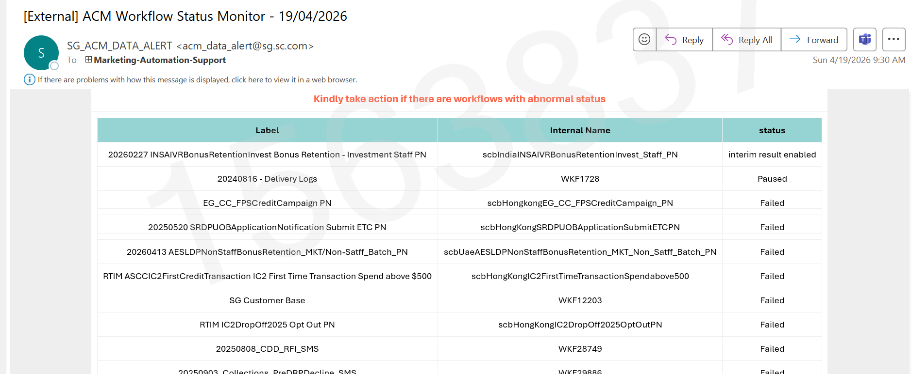
Monitoring - Abnormal workflow status monitor
Automated Alerts for failed/paused/interim results enabled workflows
Enables quick action and reduces business impact

Slide 12
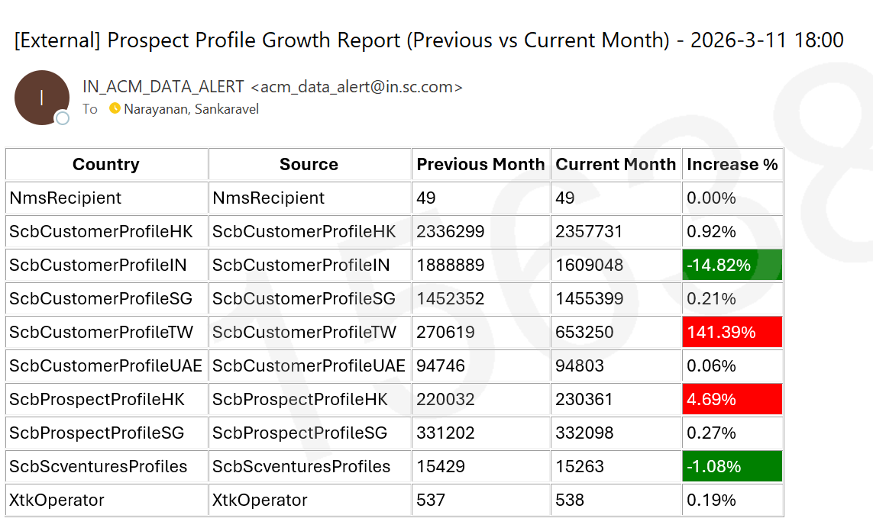
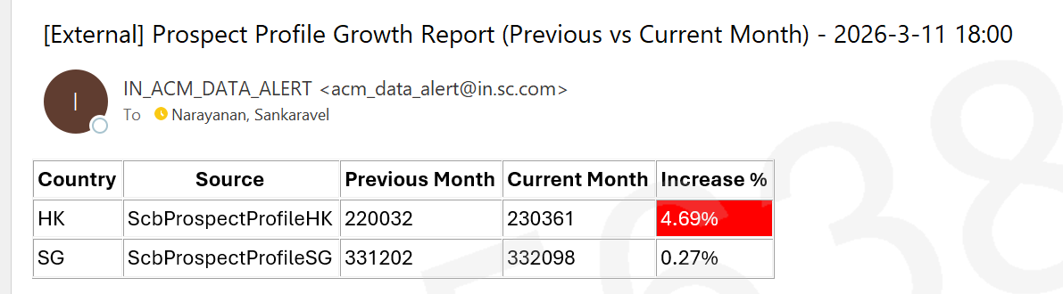
Monitor - Prospect Profile Growth Monitoring
Monthly automated report to track profile growth trends
Enables early detection of anomalies and proactive action

Slide 13
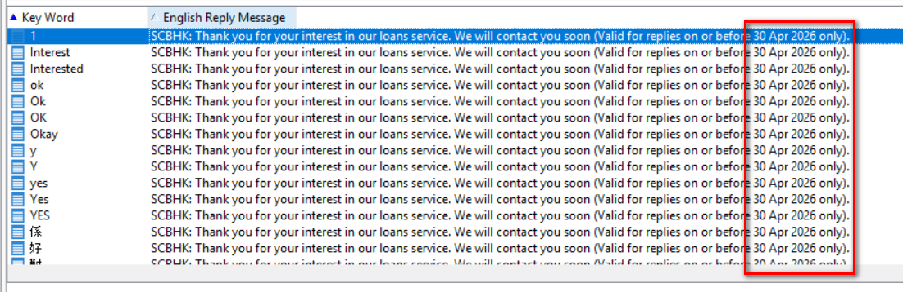
Automation – HK SMS auto reply Keywords update
Automatically update the date info on monthly basis
Eliminate manual effort and human error

Slide 14
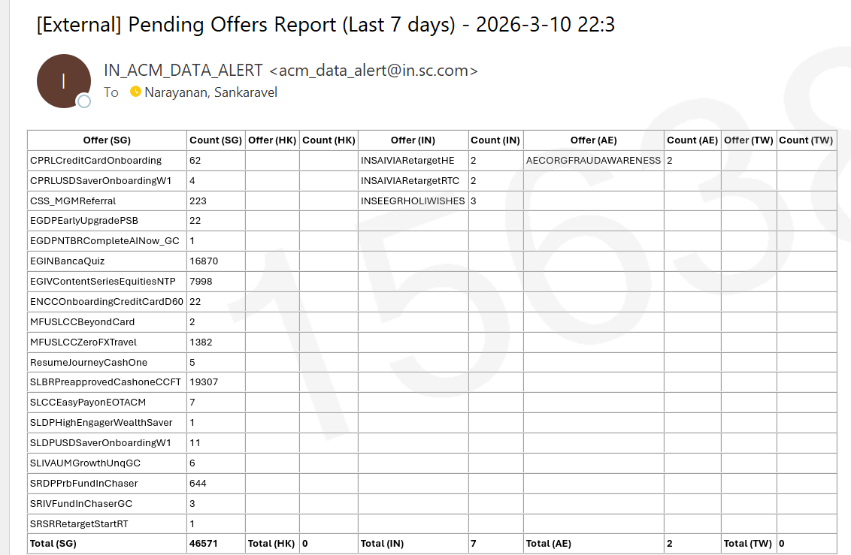
Automation - Pending Offer Report Consolidation
Centralized report for campaigns pending >7days
Reduced dependency on multiple email checks

Slide 15
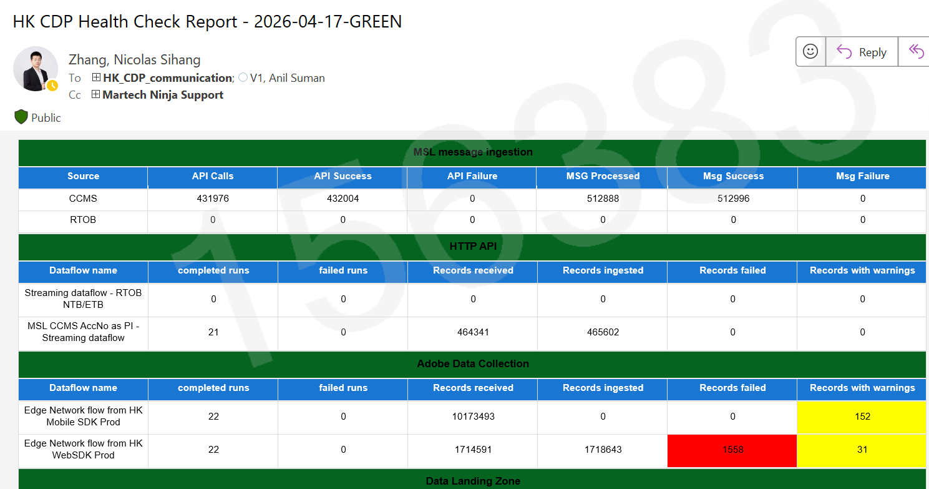
Automation - CDP Health check Automation
One-click automated health check process
Reduced manual effort and improved monitoring efficiency

Slide 16
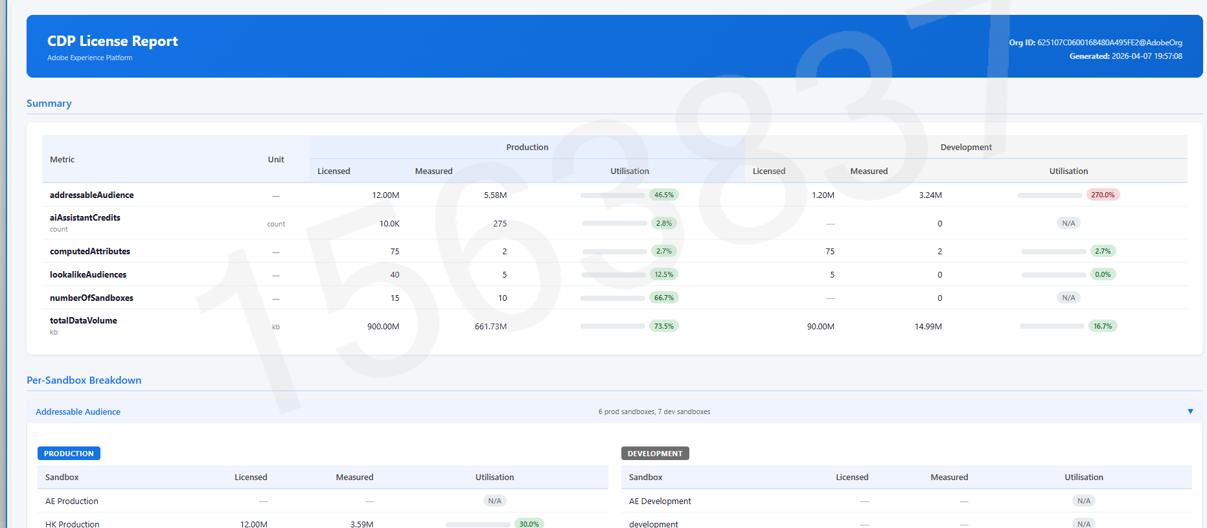
Automation - CDP License report
Automated reporting for license utilization
Reduce manual check and proactive capacity planning

Slide 17
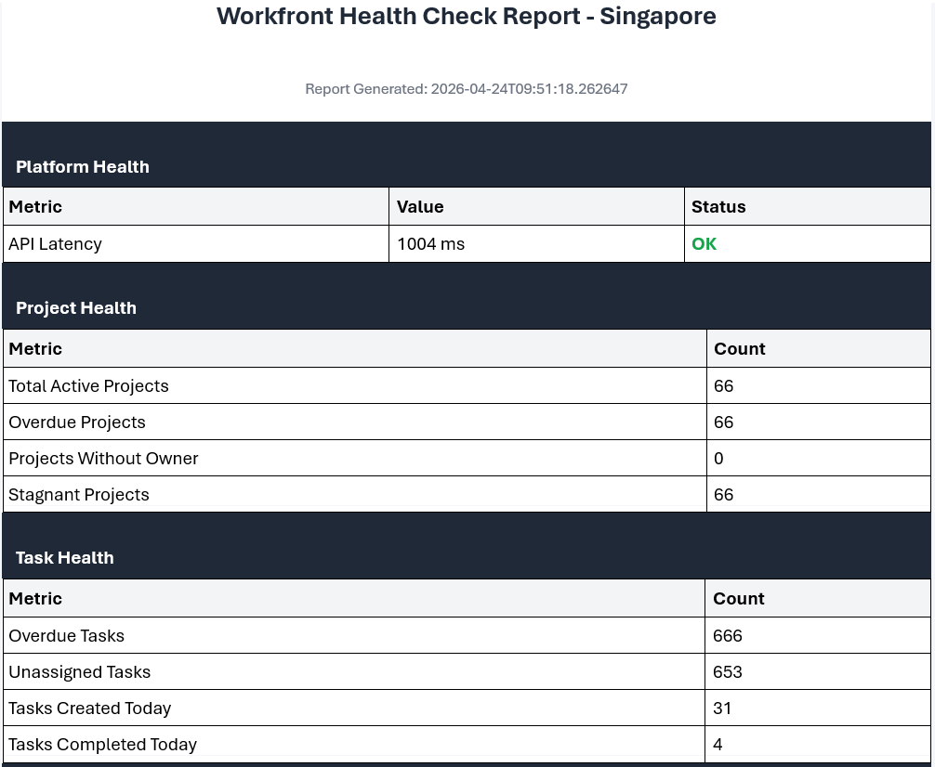
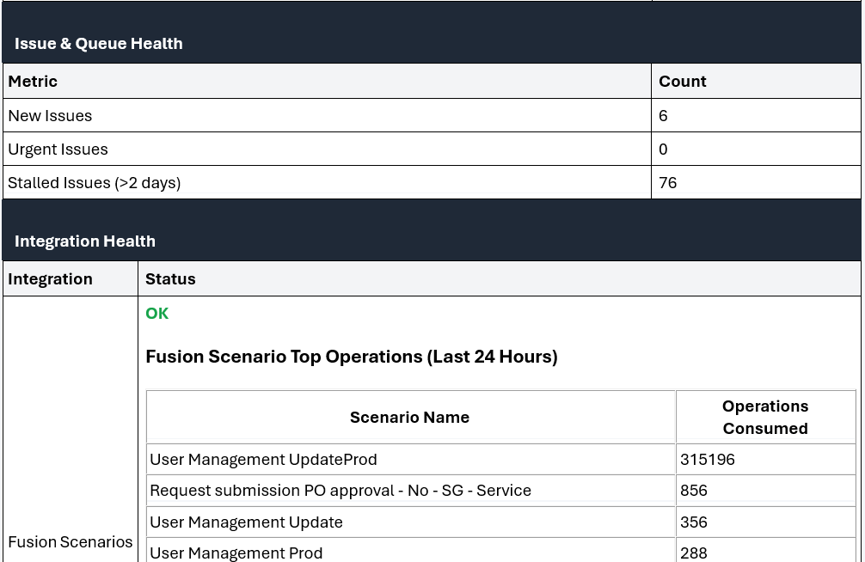
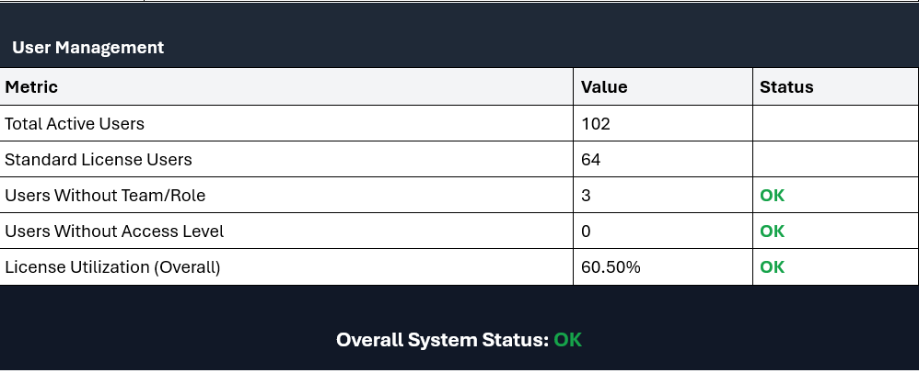
Automation - Workfront Health check
Automated health check process triggered via a single action
Improves monitoring efficiency and reduces manual operational effort

Slide 18
PE team contribution Summary
PE Contribution – Q1
System capacity optimization
DB Optimization- ACM - Identified high utilization and collaborated with dev & adobe to implement fixes . Database shrink by moving archive data from Postgres to snowflake 80% to <50%.
Introduced structured capacity review covering DB size, table bloat, SFTP usage , workflow concurrency, delivery volume etc.
ACM – Batch Scheduler Heatmap extension
Increase Monitor coverage
ACM – Prospect Profile Growth Monitoring
ACM – Bounce rate and delivery metrics
ACM - Proofpoint Block Monitoring (TW, UAE)
ACM - Active Profile Threshold Alerts(TW, UAE)
ACM - Channel-wise Bounce Report
ACM - Abnormal workflow status monitor
ACM - PEGA file data loading monitor
Reduced Manual Work
ACM - Active Profile Volume
ACM - Automated SMS keyword updates
CDP - Health check
CDP - License report automation(Review State)
Pending Offer Report Consolidation
Workfront Health check Automation(Review state)

Slide 19
Other Highlights
Other Highlights
ACM Platform stability maintained with no major outage and issue for Q1.
ACM successful upgrade from v8.6.4 to v8.9.2 with smooth execution
Adobe – Successfully supported around 800 user onboarding/management activities

Slide 20
Thank you
We cannot delivery without the help from:
Martin.Ivan@sc.com， mohammed.owaise@sc.com
Bithiralla.NandiswarReddy@sc.com , Rajasekaran.Selvam@sc.com , Kunal.Choudhary@sc.com
AnilSuman.V1@sc.com , srijith.s@sc.com
Marketing-Automation-Support@sc.com
Ect

Slide 21
Current Challenges & Q2 Plan
Current Challenges & Q2 focus
Despite implementing stats-based health check automation, the ACM health check process still takes around 30 minutes daily, leading to continued manual effort. Transition to status-based health check email triggers, reducing manual effort.
ACM - Increasing Realtime workflow concurrency requires attention
ACM - Email bounce due to invalid domain and address
Adobe Workfront & CDP onboarding – ongoing stabilization and knowledge ramp-up.
More concentration Adobe CDP & Workfront to increase monitoring coverage and help stability

Slide 22
Feedback
Feedback & Suggestions
We welcome feedback on service performance , priorities, area of improvement to better support business outcomes

